Slide 1
Data Storage Engines and Processing
Pravin Y Pawar
Adapted from Designing Machine Learning Systems by Chip Huyen

Slide 2
Data Storage Engines and Processing
Two ways
Data formats and data models specify the interface for how users can store and retrieve data
Databases (storage engines) are the implementation of how data is stored and retrieved on machines
Useful to understand different types of databases as one need to select a database appropriate for application
Typically, there are two types of workloads that databases are optimized for:
transactional processing
analytical processing
Will also explore about
ETL / ELT
Batch and Stream Processing

Slide 3
Transactional and Analytical Processing
OnLine Transaction Processing (OLTP)
A transaction refers to the action of buying or selling something
In the digital world, a transaction refers to any kind of actions that happen online:
tweeting,
ordering a ride through a ridesharing service,
uploading a new model,
watching a YouTube video, etc.
Even though these different transactions involve different types of data, the way they’re processed is similar across
applications!
The transactions are inserted as they are generated
Occasionally updated when something changes
Deleted when they are no longer needed
This type of processing is known as OnLine Transaction Processing (OLTP).
These transactions often involve users
They need to be processed fast (low latency) so that they don’t keep users waiting
The processing method needs to have high availability — e.g. the processing system needs to be available any time a
user wants to make a transaction
If system can’t process a transaction, that transaction won’t go through.

Slide 4
Transactional and Analytical Processing(2)
ACID and BaSE Properties of Transaction
Transactional databases are designed to process online transactions and satisfy the low latency, high
availability
Usually think of ACID (Atomicity, Consistency, Isolation, Durability)
Atomicity
Guarantee that all the steps in a transaction are completed successfully as a group
If any step between the transaction fails, all other steps must fail also
If a user’s payment fails, you don’t want to still assign a driver to that user.
Consistency
Guarantee that all the transactions coming through must follow predefined rules
A transaction must be made by a valid user
Isolation
Guarantee that two transactions happen at the same time as if they were isolated
Two users accessing the same data won’t change it at the same time
Durability
Guarantee that once a transaction has been committed, it will remain committed even in the case of a system failure
User ordered a ride and his phone dies, he still want his ride to come

Slide 5
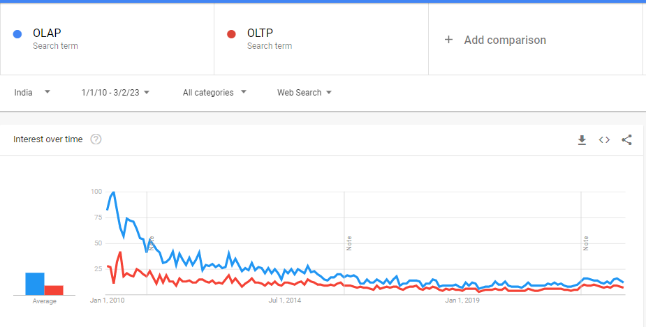
Transactional and Analytical Processing(3)
OnLine Analytical Processing (OLAP)
Transactional databases are often row-major
Each transaction is often processed as a unit separately from other transactions
Might not be efficient for questions such as “What’s the average price for all the rides in September in San Francisco?”
Analytical databases
Such kind of analytical question requires aggregating data in columns across multiple rows of data
Efficient with queries that allow you to look at data from different viewpoints
This type of processing OnLine Analytical Processing (OLAP)!
However, both the terms OLTP and OLAP
have become outdated

Slide 6
Transactional and Analytical Processing(4)
OLTP and OLAP have become outdated - reasons
First, the separation of transactional and analytical databases was due to limitations of technology
Was hard to have databases that could handle both transactional and analytical queries efficiently
Today,
Transactional databases can handle analytical queries, such as CockroachDB
Analytical databases can handle transactional queries, such as Apache Iceberg
Second, in the traditional OLTP or OLAP paradigms, storage and processing are tightly coupled
how data is stored is also how data is processed
Result in the same data being stored in multiple databases and use different processing engines to solve different types of queries
An interesting paradigm in the last decade has been to decouple storage from processing (also known as compute)
the data can be stored in the same place, with a processing layer on top that can be optimized for different types of queries
adopted by many data vendors including Google’s BigQuery, Snowflake, IBM, and Teradata

Slide 7
Transactional and Analytical Processing(5)
OLTP and OLAP have become outdated - reasons
Third, “online” has become an overloaded term that can mean many different things
initially meant “connected to the Internet”
grew to also mean “in production” — a feature is online after that feature has been deployed in production
might refer to the speed at which data is processed and made available: online, nearline, or offline
Online processing means data is immediately available for input/output
Nearline, which is short for near-online, means data is not immediately available, but can be made online quickly without human intervention
Offline means data is not immediately available, and requires some human intervention to become online
As the speed at which applications respond to users queries has become a competitive advantage, it’s become more and more important to make data available for use as fast as possible.
In many use cases, companies want online processing not just for transactional queries but also for analytical queries. Online, in this case, is synonymous to “real-time”.

Slide 8
ETL: Extract, Transform, Load
ETL (extract, transform, load) was all the rage in the data world
still relevant today for ML applications
refers to the general purpose processing and aggregating data into the shape and the format that you want
Extract
Extracting the data required from data sources
Data will likely come from multiple sources in different formats - may be corrupted or malformatted
Need to validate data and reject the data that doesn’t meet requirements
Doing it correctly can save you a lot of time downstream
Transform
Meaty part of the process, where most of the data processing is done
Might want to join data from multiple sources and clean it
Might want to standardize the value ranges
Might apply operations such as transposing, deduplication, sorting, aggregating, deriving new features, more data
validating, etc.
Load
Deciding how and how often to load transformed data into the target destination
which can be a file, a database, or a data warehouse

Slide 9
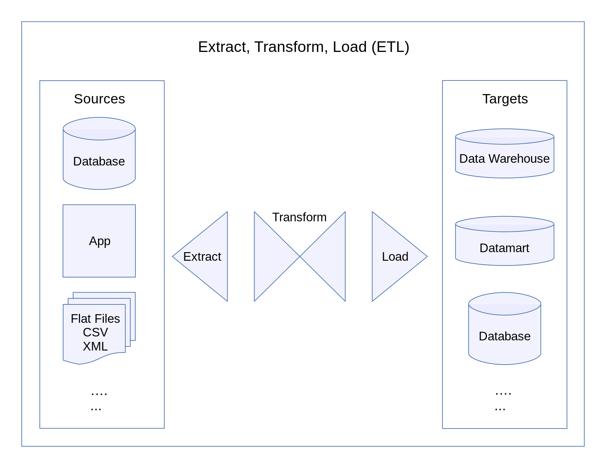
ETL: Extract, Transform, Load(2)
An overview of the ETL process
The idea of ETL sounds simple but powerful, and it’s the underlying structure of the data layer at many organizations

Slide 10
ETL: Extract, Transform, Load(3)
ETL to ELT
Because of ubiquitous Internet and powerful hardware, collecting data suddenly became so much easier!
The amount of data grew rapidly
The nature of data also changed
The number of data sources expanded
The data schemas evolved
ELT
Finding it difficult to keep data structured, some companies had this idea:
“Why not just store all data in a data lake so we don’t have to deal with schema changes? Whichever application
needs data can just pull out raw data from there and process it.”
This process of loading data into storage first then processing it later is sometimes called ELT (extract, load, transform)
This paradigm allows for the fast arrival of data since there’s little processing needed before data is stored
As data keeps on growing, this idea becomes less attractive
expensive to store everything, and inefficient to search through a massive amount of raw data for the piece of data that
you want
companies switch to running applications on the cloud and infrastructures become standardized, data structures also
become standardized
committing data to a predefined schema becomes more feasible

Slide 11
Batch vs Stream Processing
Historical vs Streaming data
Once data arrives in databases, data lakes or data warehouses its historical data
Batch jobs – kicked off periodically are used to process historical data
Batch processing is processing where data is processed in batches of jobs
e.g. once a day, compute average surge charge for rides in the last day
Hadoop MapReduce and Spark are know batch processing frameworks
Data that is still streaming in is streaming data
Ingested through real-time transports like Apache Kafka and Amazon Kinesis
Stream processing refers to doing computation on streaming data
Computations can be kicked off periodically but periods are much shorter than periods of batch jobs
Computation can be kicked off whenever need arises
Reduces latency as data can be processed as soon as its generated w/o writing to database
E.g. whenever a user requests a ride, process data stream to see what drivers are currently nearby
Apache Flink, Storm, Spark Streaming provides these processing capabilities

Slide 12
Batch vs Stream Processing(2)
Static vs Dynamic features
In ML , batch processing is used to compute feature that changes less often
e.g. drivers rating – does change quite often
Batch features – extracted through batch processing are static features!
Stream processing is used to compute features that changes quickly
For example,
how many drivers are available right now
how many rides have been requested in last one minute
how many rides will be finished in next two minutes
Median price of last 10 rides in a particular area
Features reflecting current state of system are important for price estimations
Streaming features – extracted through stream processing are dynamic features!

Slide 13
Batch vs Stream Processing(3)
Stream Processing Engines
Stream computation engines are needed to do computation on data streams
MapReduce and Spark are batch processing engines
Simple streaming computations might be carried out with built-in capabilities of real-time transports like
Apache Kafka i..e Kafka Stream processing
For ML systems that uses dynamic features, computations are rarely simple!
For example, fraud detection can have hundreds of features to be considered
Stream feature extraction logic can require complex queries with join and aggregation along different dimensions
Requires efficient stream processing engines such as Apache Flink, KSQL and Spark Streaming
Nice SQL abstraction over streaming data is provided by Flink and KSQL
Stream processing is more difficult because data amount is unbounded and data comes in at variable rates and speeds
Easier to make a stream processor do batch processing than to make batch processor to do stream processing
Flink’s maintainers arguing for years – Batch processing is a special case of stream processing

Slide 14
Thank You!
In our next session:

